Slide 1
ADS ML – Week 7 Decision Trees & Random Forest

Slide 2
Mid-term Portfolio Review ML
When? In week 8! (21/10 2015). No lesson on this date!
Portfolio consists of all notebooks required for assignments up to week 8. Tip: Create an index notebook that refers to your assignment notebooks. See example.
You will be assessed on:
Algorithm Understanding
Algorithm Application
Data Set Preparation
Tackling Pitfalls
Problem Translation
Prepare a short presentation to convince your assessor of your achievements.

Slide 3
Goals: At the end of this lesson …
You understand how to do classification with Decision Trees.
You know what Random Forest means.
And you are able to apply a Decision Tree algorithm to a dataset.
Notes:
This lesson is about the 3rd algo on supervised learning / classification: Decision Trees
It is the oldest algo, used for decades, …
… and it is extremely robust!

Slide 4
Udacity MOOC
Our Lesson | MOOC
4 | 0
5 | 2
6 | 1
7 | 3
8 | 6
9 | 8
10 | 11, 12
11 | 11, 12
12 | -
Intro to Machine Learning (Udacity MOOC)
https://www.udacity.com/course/intro-to-machine-learning--ud120

Slide 5

Machine Learning Products
With Machine Learning you can create amazing products & services!
Who was likely to survive the Titanic disaster? You will program/study this in IPython with Decision Trees.
Titanic survivors

Slide 6
Windsurfing – Data Summer 2015
10 m/s
There must be enough wind (> 10 m/s).
It must be a sunny day (> 5 hours sun).
Is linear separation a good starting point?
+
o
clear
+
o
+
o
o
+
o
o
+
+
+
o
o
o
+
+
o
o
o
sun
+
5 hours
+
+
+
+
+
+
+
+
+
+
+
+
+
cloudy
+
calm
wind
stormy
Notes:
Let’s start with a withsurfing example …

Slide 7
Windsurfing Decision Tree
10 m/s
Decision trees split the (remaining) dataset in two parts.
+
o
clear
+
o
+
o
o
+
o
o
Windy?
+
+
+
o
o
o
+
+
o
o
o
sun
+
5 hours
no
yes
+
+
+
+
+
+
+
+
+
+
+
Sunny?
+
+
+
cloudy
+
no
yes
wind
calm
stormy
+
o
Notes:
@Windy: Which of these answers give you a homogeneous dataset?
The splitting will be with vertical or horizontal lines!

Slide 8
Building a Decision Tree
x2
5
o
o
o
o
Which decision tree belongs to the left dataset?
o
o
o
o
o
o
o
o
o
o
o
o
4
o
o
o
o
+
+
+
o
o
+
+
3
o
o
+
+
o
+
o
o
o
+
+
+
2
+
+
+
+
+
+
+
+
+
1
+
+
+
+
x1
1
2
3
4
5

Slide 9
Building a Decision Tree
x2
5
o
o
o
o
x1 < ?
o
o
o
o
o
o
o
o
o
o
o
o
4
o
o
o
o
+
+
+
o
o
+
+
3
o
o
+
+
o
+
o
o
o
+
+
+
2
+
+
+
+
+
+
+
+
+
1
+
+
+
+
x1
1
2
3
4
5
Notes:
100000 euro question: Where along x1 do you split the data?

Slide 10
Building a Decision Tree
x2
5
o
o
o
o
x1 < 3
o
o
o
o
o
o
o
o
o
o
o
o
4
o
o
yes
no
o
o
+
+
+
o
o
+
+
3
o
o
+
+
o
+
x2 < ?
o
o
o
+
+
+
2
+
+
+
+
+
+
+
+
+
1
+
+
+
+
x1
1
2
3
4
5

Slide 11
Building a Decision Tree
x2
5
o
o
o
o
x1 < 3
o
o
o
o
o
o
o
o
o
o
o
o
4
o
o
yes
no
o
o
+
+
+
o
o
+
+
3
o
o
+
+
o
+
x2 < 2
o
o
o
+
+
+
2
+
+
+
+
+
+
yes
no
+
+
+
1
+
+
+
+
x1
1
2
3
4
5

Slide 12
Building a Decision Tree
x2
5
o
o
o
o
x1 < 3
o
o
o
o
o
o
o
o
o
o
o
o
4
o
o
yes
no
o
o
+
+
+
o
o
+
+
3
o
o
+
+
o
+
x2 < 2
x2 < ?
o
o
o
+
+
+
2
+
+
+
+
+
+
yes
no
+
+
+
1
+
+
+
+
x1
o
+
1
2
3
4
5

Slide 13
Building a Decision Tree
x2
5
o
o
o
o
x1 < 3
o
o
o
o
o
o
o
o
o
o
o
o
4
o
o
yes
no
o
o
+
+
+
o
o
+
+
3
o
o
+
+
o
+
x2 < 2
x2 < 4
o
o
o
+
+
+
2
+
+
+
no
yes
+
+
+
yes
no
+
+
+
1
+
+
+
+
x1
o
o
+
+
1
2
3
4
5

Slide 14
Building a Decision Tree
x2
5
o
o
o
o
x1 < 3
o
o
o
o
o
o
o
o
o
o
o
o
4
o
o
yes
no
o
o
+
+
+
o
o
+
+
3
o
o
+
+
o
+
x2 < 2
x2 < 4
o
o
o
+
+
+
2
+
+
+
no
yes
+
+
+
yes
no
+
+
+
1
+
+
+
+
x1
o
o
+
+
1
2
3
4
5

Slide 15
Coding a Decision Tree 1
First prepare your dataset (data wrangling), i.e. choose the right features X, and labels y
Next split it into train and test set!
…
from sklearn.cross_validation import train_test_split
X_train, X_test, y_train, y_test = train_test_split(X, y, test_size=0.25, random_state=0)

Slide 16
Coding a Decision Tree 2
from sklearn import tree # Include sklearn libraries
from sklearn.metrics import accuracy_score
clf = # Create classifier tree.DecisionTreeClassifier()
clf.fit(X_train, y_train) # Fit classifier with train data
pred = clf.predict(X_test) # Do predictions on test set
acc = accuracy_score(pred, # Evaluate classifier, measure accuracy y_test)

Slide 17
Compare to … (Code SVM)
from sklearn import SVC # Include sklearn libraries
from sklearn.metrics import accuracy_score
clf = # Create classifier SVC(kernel=‘rbf’, C=1)
clf.fit(X_train, y_train) # Fit classifier with train data
pred = clf.predict(X_test) # Do predictions on test set
acc = accuracy_score(pred, # Evaluate classifier, measure accuracy y_test)
Notes:
All sklearn classifiers follow the same pattern!

Slide 18
The min_samples_split Parameter
min_samples_split = 5
Now we cannot split a node of 5 (or less) samples any further!
100
60
40
37
23
30
10
19
4

Slide 19
Other Parameters
Overfitted?
Some other parameters:
criterion Measures the quality of a split. Supported criteria are “gini” for the data impurity and “entropy” for the information gain.
min_samples_leaf The minimum number of samples required to be at a leaf node.
max_depth The maximum depth of the tree.
random_state the seed used by the random number generator
More in the sklearn documention
min_samples_split = 2
min_samples_split = 50

Slide 20
Decision Tree Summary
Prone to overfitting (limit growth of tree!)
Easy to interpret (graphically)
Oldest ML algo, used for decades
Extremely robust!

Slide 21
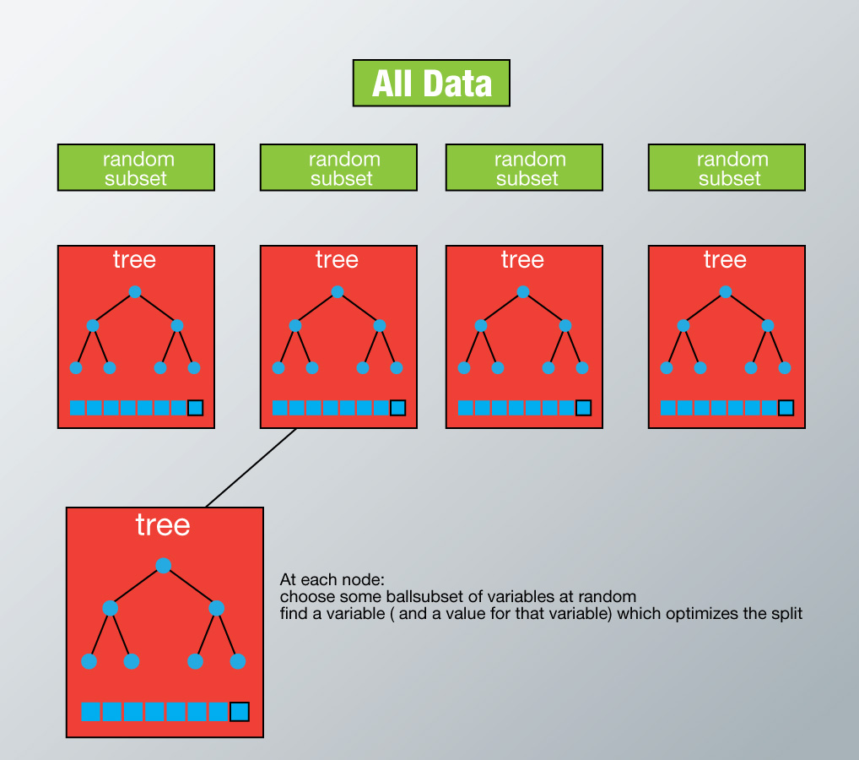
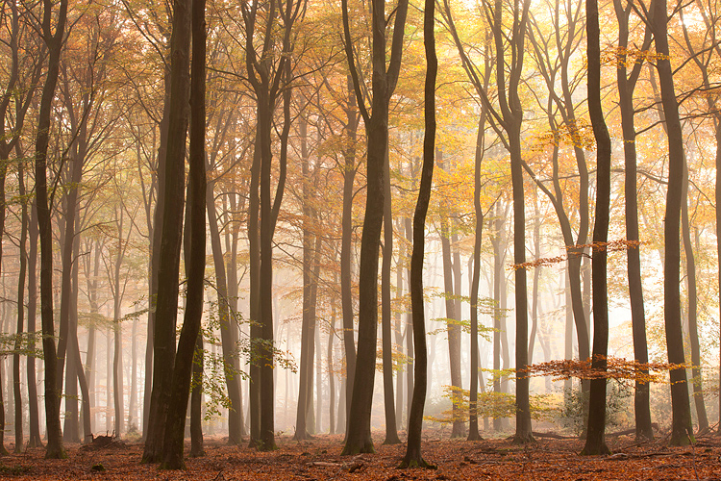
Forest of Randomized Trees
Random Forest builds multiple decision trees on various random subsets of the dataset.
Majority vote mechanism is used for prediction. This is a.k.a. ensemble learning.
Outcome of Random Forest is also feature importance!

Slide 22
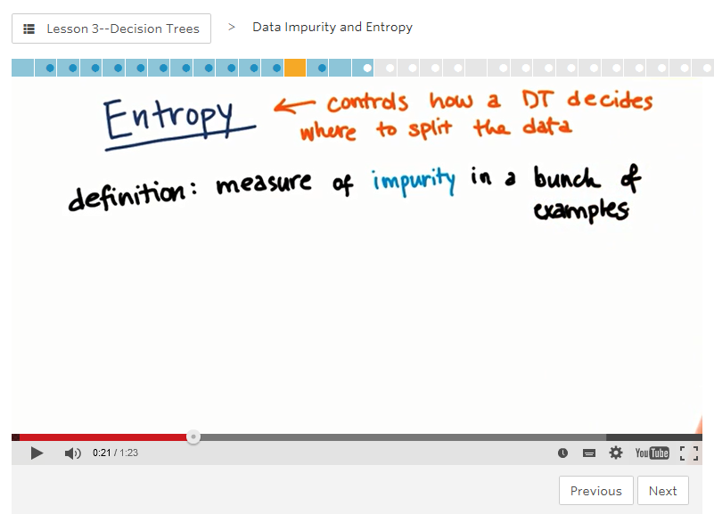
Assignment
Study Udacity MOOC Intro ML 3 part on Entropy (Info Gain) or Impurity.
Study IPython notebook “Titanic”.
Use sklearn documentation to figure out with Random Forest which are the most important feature in the Titanic dataset.
Add this extended notebook to your portfolio.

Slide 23
To Do’s
Entropy
Controls how DT decides where to split
Try to make subsets that are as pure as possible
Formula:
Pi = fraction of the samples
Min = 0 (homogeneous data, all samples belong to the same class)
Max = 1 (50-50 mix)
[Plaatjes sets E = 0 en E = 1]
Information Gain
Entropy of parent node – weighted average of entropy of the children
[plaatje parent 50-50 naar 2 homogene children sets: IG = 1]
DT maximizes Info Gain!

